Slide 1
Real World Web Design and Development
Shaopeng Zhang
Front end Developer
Data Technologies Web Services Team
Bloomberg L.P.
02/09/2016
Notes:
In this lecture I will discuss real world application design and development, with a focus on web front end development workflow, tools and tips, using some demos. Topics include how designers and developers interact with each other, how to prototype for an application and verify with stakeholders, and how to continuously build the application as requirements evolve.

Slide 2
Introduction
Have you written a web page? Of course you have. Do you wonder what web design and development is like in real world?
This talk will introduce the common challenges in web design and development, as well as tools and methodology to continuously build a product that meets all stakeholders’ expectation.

Slide 3
Agenda
Requirements: What they are and why they are important
Prototypes as communication tool
How web designers and developers work together
(Code sample) How to continuously build a product
Resources

Slide 4
About Me
Front end Developer at Bloomberg L.P.
Jan 2015 to Present
Full stack dev for OpenFIGI.com
Technology knowledge sharing
Web development consulting
Prototyper, Developer at Siemens Corporate Research
Feb 2011 to Jan 2015
MS in Information Science from University of Pittsburgh
BE in Computer Science and Tech from Beijing Jiaotong University

Slide 5
Let’s build a to-do list
A to-do list is like “HelloWorld” in front end web development.
Notes:
Use case: Add an item to to-do list
Primary Actor: to-do list owner
Scope: A to-do List
Description: The to-do list owner adds an item to the existing list
Postconditions: The new item is added to the list and saved for future retrieval.
Preconditions: The list is already existing.
Triggers: The user focuses to the new item text input.
Basic flow:
1. The system provides a place for user’s input for the new to-do item.
2. The user provides input of the content of the to-do item.
3. The user selects the function to submit the to-do item.
4. The system checks the to-do item is valid.
5. The system adds the valid item to the list
6. The system saves the item.
7. The system confirms with the user the operation has been successful.
8. The user acknowledges the status.
Alternative Flows:
4a. If the system finds out that the item is empty, then
4a-1. The system alerts the user that the content is empty, and demands a valid input
4a-2. The user provides a valid input
[Go to 4]

Slide 6
“What are the requirements?”
Tools we use to maintain requirements
Vision document
Backlog
User stories
Use cases
Notes:
Vision document
- Introduction
- Problem statement
- Product Features
- Scope and limitations
A Vision Document is a document that describes a compelling idea or values or future state for a particular organization, product or service. It defines the stakeholders view of the product/service to be developed, specified in terms of the stakeholders key needs and features. Containing an outline of the envisioned core requirements, it provides the contractual basis for the more detailed technical requirements.
Backlog
The agile product backlog in Scrum is a prioritized features list, containing short descriptions of all functionality desired in the product.
- Features
- Bugs
- Technical work
- Knowledge acquisition
In software and systems engineering, a use case is a list of actions or event steps, typically defining the interactions between a role (known in the Unified Modeling Language as an actor) and a system, to achieve a goal.

Slide 7
A Vision Document Example
1. Introduction
This document outlines the requirements of the To-Do List application. The purpose of this document is to (1) identify problems (2) outline features, and (3) identify restriction and challenges.
2. Problem Statement
The problem of…
affects…
causing the impact of…

Slide 8
A Vision Document Example
3. A successful solution would provide
- a one-glance to-do list
- the ability to add and mark items in the list
4. Product features
- Display to-do list
- Add an item in to-do list
- Mark an item in to-do list
- Remove an item in to-do list
- …

Slide 9
A Vision Document Example
5. Restrictions and Challenges
…

Slide 10
A Backlog Example
Type | Title | Points
02/08 – 02/12
Feature | Display to-do list | 3
Feature | Add to-do item | 4
Bug | Empty to-do item is also added | 2
Usability | (De)select item more easily | 1
Continuous Integration | Set up build tools | 5

Slide 11
A User Story Example
As a student, I want to maintain a list of to-do items e.g. my assignments.
As a developer, I want to be able to add an item to my to-do list.

Slide 12
A Use Case Example
Use case: Add an item to to-do list
Primary Actor: To-do list owner
Scope: A to-do List
Description: The to-do list owner adds an item to the existing list
Postconditions: The new item is added to the list and saved for future retrieval.
Preconditions: The list is already existing.
Basic flow:
1. The system provides a place for user’s input for the new to-do item.
2. The user provides input of the content of the to-do item, and selects the function to submit the to-do item.
3. The system checks the to-do item is valid.
4. The system adds the valid item to the list, saves the item, and confirms with the user the operation has been successful.
5. The user acknowledges the status.
Alternative Flows:
3a. If the system finds out that the item is empty, then
3a-1. The system alerts the user that the content is empty, and demands a valid input
3a-2. The user provides a valid input
[Go to 3]
Notes:
Break up into 2 slides

Slide 13
A Use Case Example
Basic flow:
1. The system provides a place for user’s input for the new to-do item.
2. The user provides input of the content of the to-do item, and selects the function to submit the to-do item.
3. The system checks the to-do item is valid.
4. The system adds the valid item to the list, saves the item, and confirms with the user the operation has been successful.
5. The user acknowledges the status.
Alternative Flows:
3a. If the system finds out that the item is empty, then
3a-1. The system alerts the user that the content is empty, and demands a valid input
3a-2. The user provides a valid input
[Go to 3]
Notes:
Break up into 2 slides

Slide 14
A Use Case Example
Alternative Flows:
3a. If the system finds out that the item is empty, then
3a-1. The system alerts the user that the content is empty, and demands a valid input
3a-2. The user provides a valid input
[Go to 3]
Notes:
Break up into 2 slides

Slide 15
How expectations are NOT met
Exp1
Product Manager & Other Stakeholders
Requirements
Exp2
Exp3
Designer
Developer
Product
End User
Exp4
Notes:
The (simplified) traditional product development lifecycle. Notice Designer and Developer can form their own interpretation of the requirements.

Slide 16
Prototyping
A Prototype is
A tool for communication
Incomplete
Fast
(Ideally) to be built/modified by both designers and developers
Notes:
A prototype is an incomplete version of a software (or a component) being developed. It is developed to get feedback from stakeholders early in the project.

Slide 17
Prototyping
Exp3
Exp2
Developer
Updated design
Designer
Updated prototype
Prototype
Exp4
Clarified requirements
End User
Exp1
Feedback
Product Manager & Other Stakeholders
Notes:
A prototype is a communication tool that translates every stakeholder’s expectation into one artifact, and achieves agreement on requirements.

Slide 18
Prototyping
Developer
Log in
Prototype
Designer
Sign up
Prototype
Dash-board
Prototype
Shopping Cart
Prototype
Product Manager & Other Stakeholders
End User
Notes:
You can (and should) spin multiple prototypes for different components of the product.

Slide 19
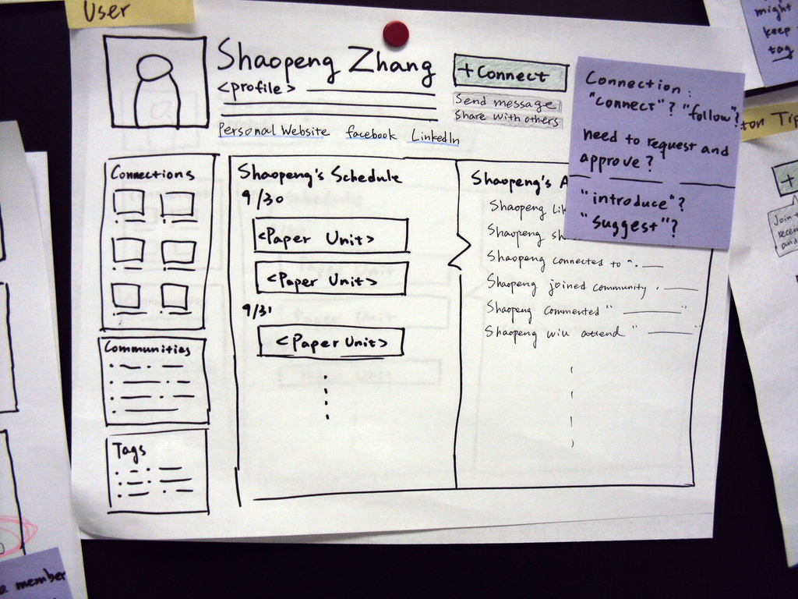
Paper Prototype
Notes:
Paper prototypes are fast to develop (or to draw). Anyone in the team can produce them. They are guaranteed to be thrown away. They will not be confused with the final product.

Slide 20
Other Prototypes
Microsoft PowerPoint: a storyboard to illustrate a series of user-system interaction (use case).
Interactive: a minimal running program that provides the UI interactions to the user.
http://plnkr.co/edit/9s3RAnFEE2r8PWeCQmLO?p=preview
When building a prototype
Keep it fast
Keep it small
Keep it “ugly”
Notes:
https://en.wikipedia.org/wiki/Comparison_of_software_prototyping_tools

Slide 21
Prototype --> Product?
In front end web development, we can integrate a prototype into the product we are building.
Notes:
Stress: taking pieces of prototype and integrate into product.

Slide 22
Let’s build a to-do List
A to-do list is like “HelloWorld” in front end web development.
Real world precondition:
Vision document
Backlog
Use cases
(Ideally) Prototypes verified with stakeholders
Notes:
Use case: Add an item to todo list
Primary Actor: todo list owner
Scope: A Todo List
Description: The todo list owner adds an item to the existing list
Postconditions: The new item is added to the list and saved for future retrieval.
Preconditions: The list is already existing.
Triggers: The user focuses to the new item text input.
Basic flow:
1. The system provides a place for user’s input for the new todo item.
2. The user provides input of the content of the todo item.
3. The user selects the function to submit the todo item.
4. The system checks the todo item is valid.
5. The system adds the valid item to the list
6. The system saves the item.
7. The system confirms with the user the operation has been successful.
8. The user acknowledges the status.
Alternative Flows:
4a. If the system finds out that the item is empty, then
4a-1. The system alerts the user that the content is empty, and demands a valid input
4a-2. The user provides a valid input
[Go to 4]

Slide 23
Working Together
Designers deliver
Wireframes
(structure)
Storyboards
(interaction)
Visual style guides (visual detail)
Developers deliver
HTML
(structure)
JavaScript
(interaction)
CSS
(visual detail)
Prototype http://plnkr.co/edit/9s3RAnFEE2r8PWeCQmLO?p=preview

Slide 24
Web Designer
Page layout
Typography
Color
Animation
Interaction

Slide 25
Web Developer
Server/client architecture
HTML
CSS
JavaScript
Database, server side technology (Python, Node.js, ASP.NET, Java etc.)

Slide 26
Wireframe
Buy milk
Give presentation at temple
Add

Slide 27
Storyboard
1
2
Buy milk
Buy milk
Give presentation at temple
Give presentation at temple
Add
Pay credit card
Add
3
4
Buy milk
Buy milk
Give presentation at temple
Give presentation at temple
Pay credit card
Add
Pay credit card
Add

Slide 28
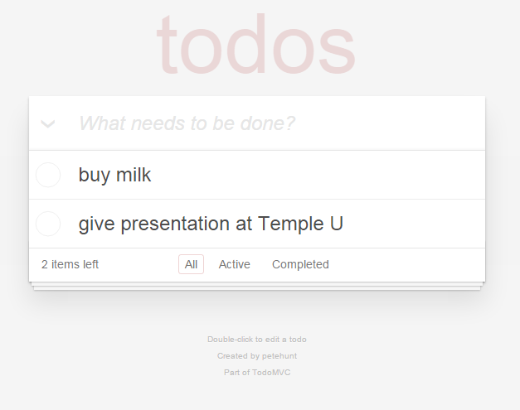
Style Guides
Font: Arial 42px rgba(175, 47, 47, 0.15)
Height: 50px
Height: 10px
Font: Arial 32px italic #EEEEEE
Height: 42px
Font: Arial 32px #666666
Height: 40px
Font: Arial 300 12px #AAAAAA
Height: 32px
Shadow: #EEEEEE, Blur 10px, Offset 10px, 10px
Height: 16px
Font: Verdana 9px #EEEEEE
Background: #F2F2F2
Margin: 10px
Width: 20px
Center Align
http://todomvc.com/examples/react/#/

Slide 29
Things a Front End Developer Needs
System environment
Running platform, aka the server and the browser
Frameworks and libraries
Development tools
IDE, Code editor
Version control system
Build tools
Notes:
Unix, Linux, MacOS are popular systems for web development. Windows is also a good choice.
Browser compatibility is always the issue to keep an eye on.
Should you use a framework? What are the pros and cons. Think of the future.
Code editor is always good for beginner web developers.
You NEED a version control system. Learn Git if you have not.
Yes. HTML, JS, CSS needs build tools. You work on src, and run dist – We’ll take a look later.

Slide 30
Frameworks and Libraries
A Framework
An abstraction of software
Defines how a system is constructed
Generic functionality can be changed with user-written code
A Library
A collection of reusable objects and methods
Can be easily imported into a system
Examples of Frameworks
Angular, Ember, Express-generator
Examples of Libraries
jQuery, React, Bluebird

Slide 31
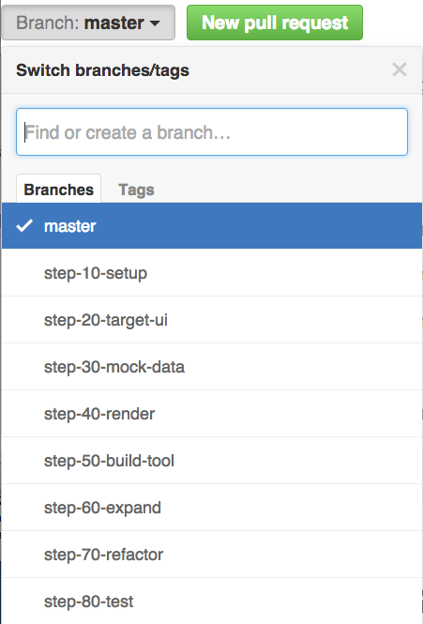
Coding Walkthrough
https://github.com/szhangpitt/todo-step-by-step

Slide 32
Resources
Book: Managing Software Requirements: A Use Case Approach
Book: Cognitive Psychology and its Implications, Sixth Edition
Link: Comparison of software prototyping tools
Link: Google Web Fundamentals
Link: Mozilla Developer Network
Link: Writing Testable JavaScript
Notes:
http://www.amazon.com/Managing-Software-Requirements-Approach-Edition/dp/032112247X
http://www.amazon.com/Cognitive-Psychology-its-Implications-Sixth/dp/0716701103/ref=sr_1_3?s=books&ie=UTF8&qid=1454430261&sr=1-3&keywords=cognitive+psychology+and+its+implications
https://en.wikipedia.org/wiki/Comparison_of_software_prototyping_tools
https://developers.google.com/web/fundamentals/?hl=en
https://developer.mozilla.org/en-US/
http://alistapart.com/article/writing-testable-javascript

Slide 33
Summary
Skill sets for designers and developers
“What are the requirements?”
Use prototypes as a communication tool to manage expectations.
Start with something simple. Continuously integrate into product.

Slide 34
Thank You
Feel free to contact me with questions about working at Bloomberg, or about web design and development.
szhang351@bloomberg.net

